Slide 1


Slide 2
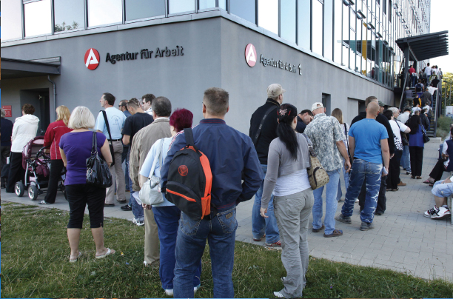
28
THE BUSINESS CYCLE, INFLATION, AND DEFLATION
Notes:
Notes and teaching tips: 4, 19, 20, 22, 25, 31, 40, 56, 57, 58, and 67.
To view a full-screen figure during a class, click the expand button.
To return to the previous slide, click the shrink button.
To advance to the next slide, click anywhere on the full screen figure.
Applying the principles of economics to interpret and understand the news is a major goal of the principles course. You can encourage your students in this activity by using the two features: Economics in the News and Economics in Action.
(1) Before each class, scan the news and select two or three headlines that are relevant to your session today. There is always something that works. Read the headline and ask for comments, interpretation, discussion. Pose questions arising from it that motivate today’s class. At the end of the class, return to the questions and answer them with the tools you’ve been explaining.
(2) Once or twice a semester, set an assignment, for credit, with the following instructions:
(a) Find a news article about an economic topic that you find interesting.
(b) Make a short bullet-list summary of the article.
(c) Write and illustrate with appropriate graphs an economic analysis of the key points in the article.
Use the Economics in the News features in your textbook as models.

Slide 3
After studying this chapter, you will be able to:
Explain how aggregate demand shocks and aggregate supply shocks create the business cycle
Explain how demand-pull and cost-push forces bring cycles in inflation and output
Explain the causes and consequences of deflation
Explain how the short-run and long-run tradeoff between inflation and unemployment

Slide 4
The Business Cycle
The business cycle is easy to describe but hard to explain.
Two approaches to understanding the business cycle are:
Mainstream business cycle theory
Real business cycle theory
Mainstream Business Cycle Theory
Because potential GDP grows at a steady pace while aggregate demand grows at a fluctuating rate, real GDP fluctuates around potential GDP.
Notes:
This mainstream theory comes in a number of special forms that differ in what is regarded as the source of fluctuations in aggregate demand growth and the source of money wage stickiness.
Keynesian Cycle Theory In Keynesian cycle theory, fluctuations in investment driven by fluctuations in business confidence—summarized in the phrase “animal spirits”—are the main source of fluctuations in aggregate demand.
Monetarist Cycle Theory In monetarist cycle theory, fluctuations in both investment and consumption expenditure, driven by fluctuations in the growth rate of the quantity of money, are the main source of fluctuations in aggregate demand.
Both the Keynesian and monetarist cycle theories simply assume that the money wage rate is rigid and don’t explain that rigidity. Two newer theories seek to explain money wage rate rigidity and to be more careful about working out its consequences.
New Classical Cycle Theory In new classical cycle theory, the rational expectation of the price level, which is determined by potential GDP and expected aggregate demand, determines the money wage rate and the position of the SAS curve. In this theory, only unexpected fluctuations in aggregate demand bring fluctuations in real GDP around potential GDP.
New Keynesian Cycle Theory The new Keynesian cycle theory emphasizes the fact that today’s money wage rates were negotiated at many past dates, which means that past rational expectations of the current price level influence the money wage rate and the position of the SAS curve. In this theory, both unexpected and currently expected fluctuations in aggregate demand bring fluctuations in real GDP around potential GDP.
The mainstream cycle theories don’t rule out the possibility that occasionally an aggregate supply shock might occur. An oil price rise, a widespread drought, a major hurricane, or another natural disaster, could, for example, bring a recession. But supply shocks are not the normal source of fluctuations in the mainstream theories. In contrast, real business cycle theory puts supply shocks at centre stage.

Slide 5
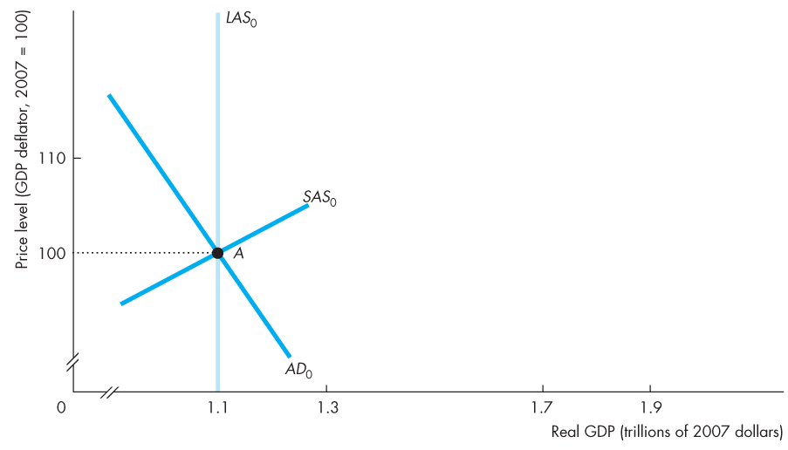
The Business Cycle
Initially, potential GDP is $1.1 trillion and the economy is at full employment at point A.

Slide 6
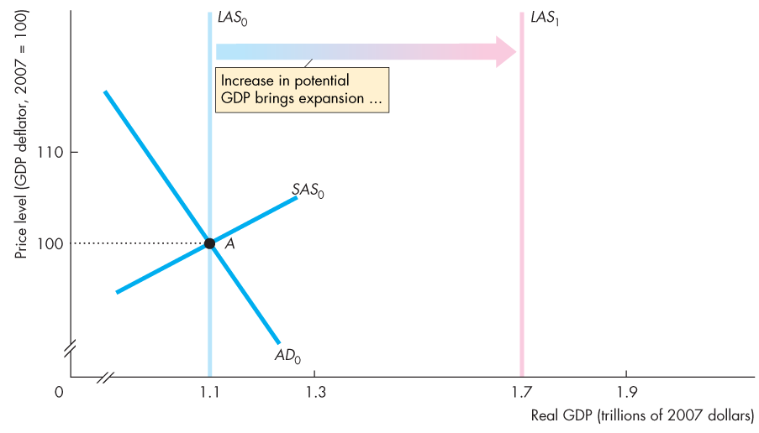
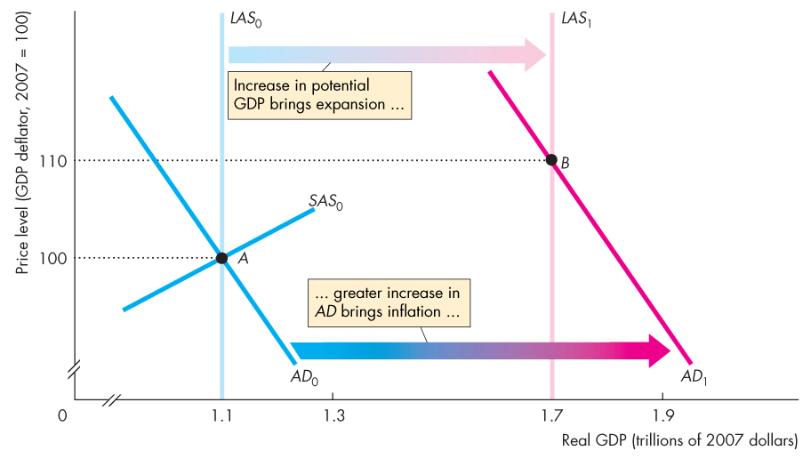
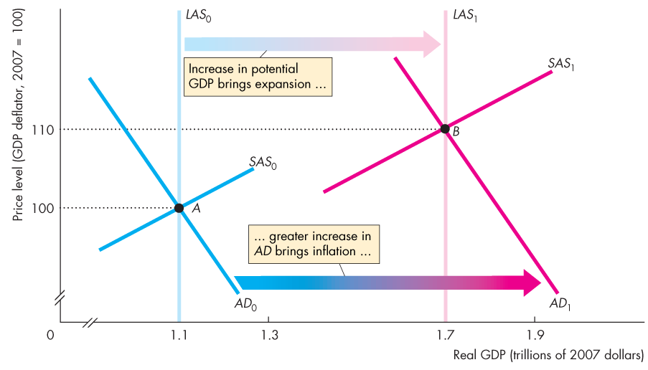
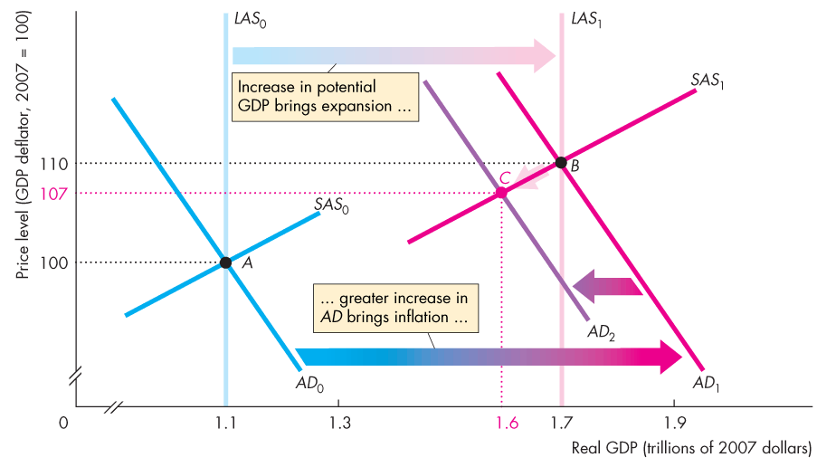
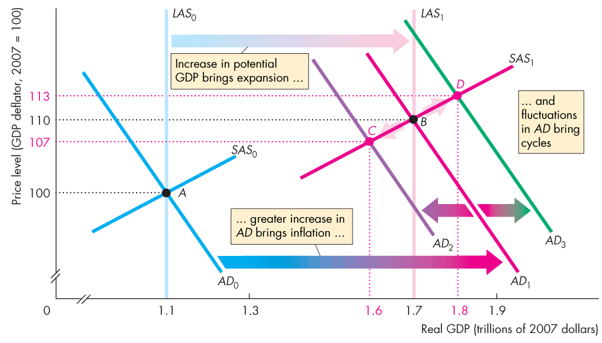

Slide 7
The Business Cycle
Potential GDP increases to $1.7 trillion and the LAS curve shifts rightward.

Slide 8
The Business Cycle
During an expansion, aggregate demand increases and usually by more than potential GDP.

Slide 9
The Business Cycle
The AD curve shifts to AD₁.

Slide 10
The Business Cycle
Assume that during this expansion the price level is expected to rise to 110 and that the money wage rate was set on that expectation.

Slide 11
The Business Cycle
The SAS shifts to SAS₁.

Slide 12
The Business Cycle
The economy remains at full employment at point B.
The price level rises as expected from 100 to 110.

Slide 13
The Business Cycle
But if aggregate demand increases more slowly than potential GDP, the AD curve shifts to AD₂.

Slide 14
The Business Cycle
The economy moves to point C.
Real GDP growth is slower; inflation is less than expected.

Slide 15
The Business Cycle
But if aggregate demand increases more quickly than potential GDP, the AD curve shifts to AD₃.

Slide 16
The Business Cycle
The economy moves to point D.
Real GDP growth is faster; inflation is higher than expected.

Slide 17
The Business Cycle
Economic growth, inflation, and the business cycle arise from the relentless increases in ...

Slide 18
The Business Cycle
… potential GDP, faster (on average) increases in aggregate demand, and fluctuations in the pace of aggregate demand growth.

Slide 19
The Business Cycle
Real Business Cycle Theory
  Real business cycle theory regards random fluctuations in productivity as the main source of economic fluctuations.
  These productivity fluctuations are assumed to result mainly from fluctuations in the pace of technological change.
  But other sources might be international disturbances, climate fluctuations, or natural disasters.
  We’ll explore RBC theory by looking first at its impulse and then at the mechanism that converts that impulse into a cycle in real GDP.
Notes:
The origins of RBC theory can be traced to the rational expectations revolution set off by Robert E. Lucas, Jr., but the first demonstrations of the power of this theory were given by Edward Prescott and Finn Kydland.
Robert E. Lucas, Jr. was awarded the Nobel Prize for Economic Science for his work on rational expectations.
Edward Prescott and Finn Kydland were awarded the Nobel Prize for Economic Science for their work on real business cycle theory.
Today, RBC theory is part of a broad research agenda called dynamic general equilibrium analysis, and hundreds of young macroeconomists do research on this topic.

Slide 20
The Business Cycle
The RBC Impulse
  The impulse is the productivity growth rate that results from technological change.
  Most of the time, technological change is steady and productivity grows at a moderate pace.
  But sometimes productivity growth speeds up, and occasionally it decreases—labour becomes less productive, on average.
  A period of rapid productivity growth brings an expansion, and a decrease in productivity triggers a recession.
  The figure on the next slide shows the RBC impulse.
Notes:
Classroom activity
Check out Economics in Action: The Real Business Cycle Impulse

Slide 21
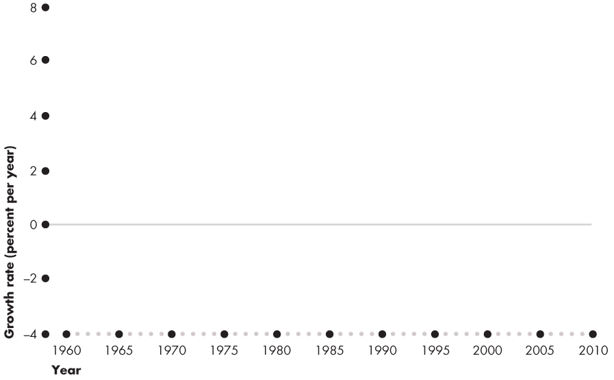
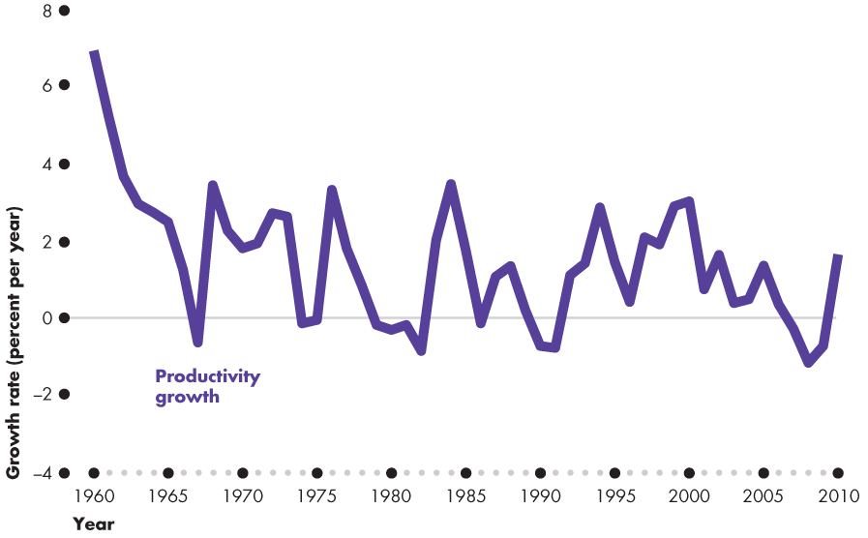
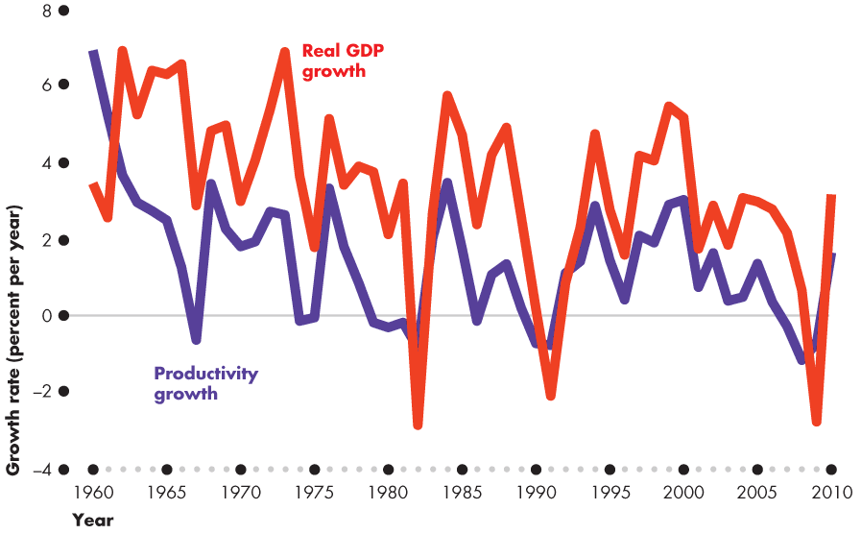

Slide 22
The Business Cycle
The RBC Mechanism
  Two effects follow from a change in productivity that gets an expansion or a contraction going:
  1. Investment demand changes.
  2. The demand for labour changes.
Notes:
Explain that technological change makes some existing capital obsolete and temporarily decreases productivity. Firms expect the future profits to fall and see their labour productivity falling. With lower profit expectations, they cut back their purchases of new capital, and with lower labour productivity, they plan to lay off some workers. So the initial effect of a temporary fall in productivity is a decrease in investment demand and a decrease in the demand for labour.

Slide 23
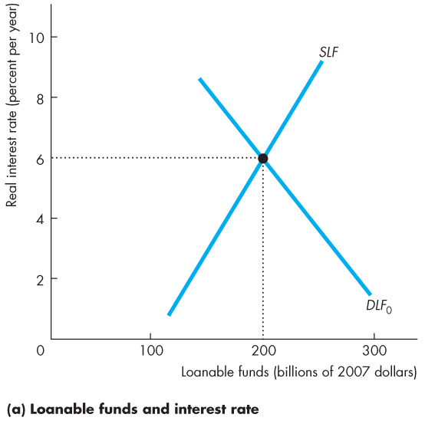
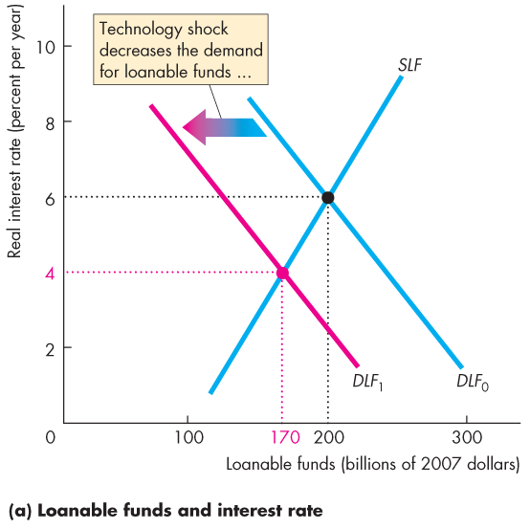
The Business Cycle
  Figure 28.2(a) shows the effects of a decrease in productivity on investment demand.
  A decrease in productivity decreases investment demand, which decreases the demand for loanable funds.
  The real interest rate falls and the quantity of loanable funds decreases.

Slide 25
The Business Cycle
The Key Decision: When to Work?
  To decide when to work, people compare the return from working in the current period with the expected return from working in a later period.
  The when-to-work decision depends on the real interest rate. The lower the real interest rate, the smaller is the supply of labour today.
  Many economists believe that this intertemporal substitution effect is small, but RBC theorists believe that it is large and the key feature of the RBC mechanism.
Notes:
Explain to the students that they make the “when to work” decision every day:
Suppose the student’s goal in this course is to get an A. To achieve this goal, the student works hard most of the time. But during the few days before the midterm and final exams, the student works especially hard. Why? Because the student believes that the return from studying close to the exam is greater than the return from studying when the exam is a long time away. So during the term, the student takes time off for the movies and other leisure pursuits, but at exam time, the student studies every evening and weekend.

Slide 26
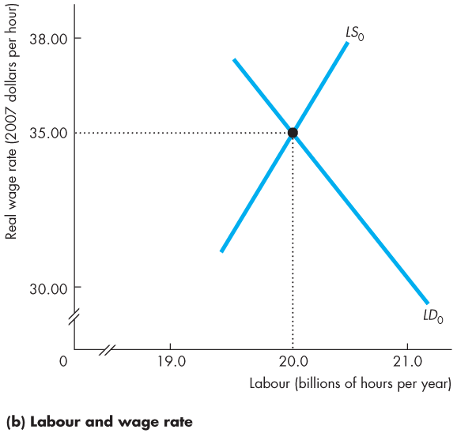
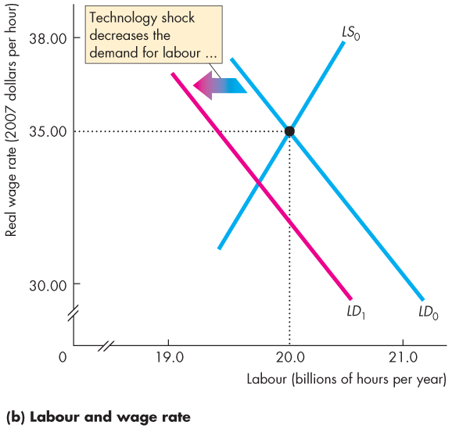
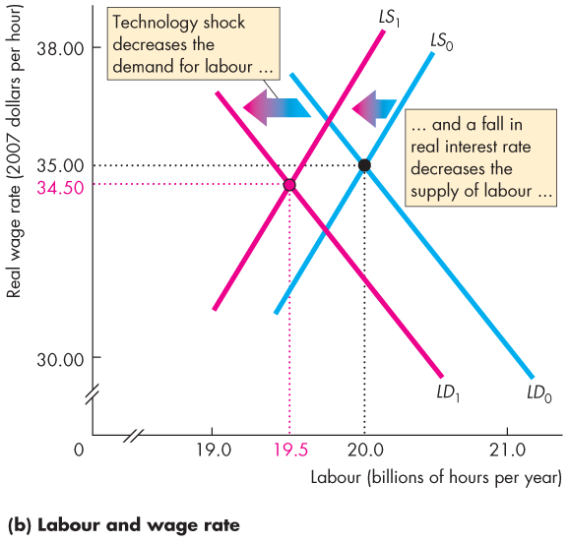
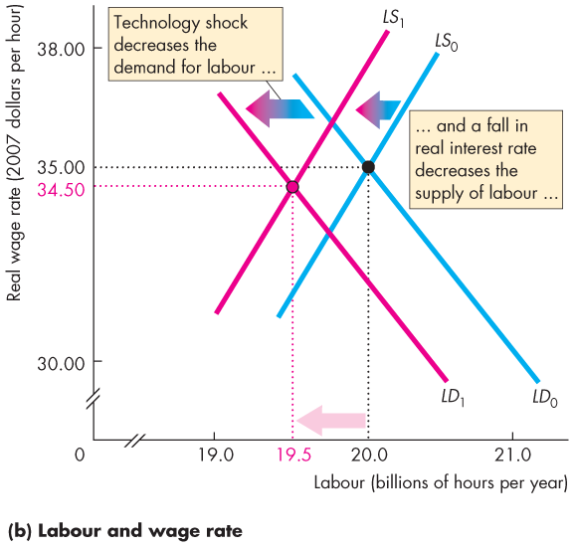
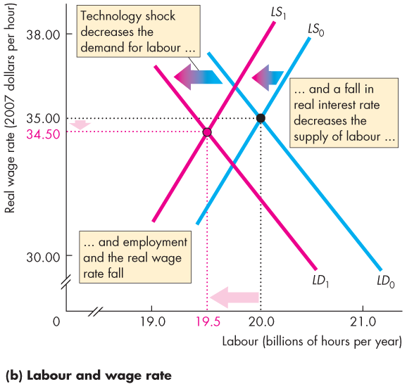
The Business Cycle
  Figure 28.2(b) shows the effects of a decrease in productivity on the demand for labour.
  The fall in the real interest rate decreases the supply of labour.
  Employment and the real wage rate decrease.

Slide 28
The Business Cycle
Criticisms and Defence of RBC Theory
  The three main criticisms of RBC theory are that
  1. The money wage rate is sticky, and to assume otherwise is at odds with a clear fact.
  2. Intertemporal substitution is too weak a force to account for large fluctuations in labour supply and employment with small real wage rate changes.
  3. Productivity shocks are as likely to be caused by changes in aggregate demand as by technological change.

Slide 29
The Business Cycle
  Defenders of RBC theory claim that
  1. RBC theory explains the macroeconomic facts about the business cycle and is consistent with the facts about economic growth. RBC theory is a single theory that explains both growth and cycles.
  2. RBC theory is consistent with a wide range of microeconomic evidence about labour supply decisions, labour demand and investment demand decisions, and information on the distribution of income between labour and capital.

Slide 30
Inflation Cycles
  In the long run, inflation occurs if the quantity of money grows faster than potential GDP.
  In the short run, many factors can start an inflation, and real GDP and the price level interact.
  To study these interactions, we distinguish two sources of inflation:
  Demand-pull inflation
  Cost-push inflation

Slide 31
Inflation Cycles
  Demand-Pull Inflation
  An inflation that starts because aggregate demand increases is called demand-pull inflation.
  Demand-pull inflation can begin with any factor that increases aggregate demand.
  Examples are a cut in the interest rate, an increase in the quantity of money, an increase in government expenditure, a tax cut, an increase in exports, or an increase in investment stimulated by an increase in expected future profits.
Notes:
The potential difficulty with both demand-pull and cost-push inflation stories is how the one-time increase translates into an inflationary process. It is relatively easy to come up with stories as to why aggregate demand might shift continuously to the right, for example because of persistent and growing government budget deficits. What is a little harder is to provide a plausible story as to why the monetary authorities would continue to accommodate this with continuous increases in the quantity of money. Point out that this has been rare in Canada, and has tended to happen when the political situation was such that the Bank of Canada was not willing to be blamed for an increase in unemployment. In other countries, particularly where the central bank is less independent than the Bank of Canada, it has been more common.

Slide 32
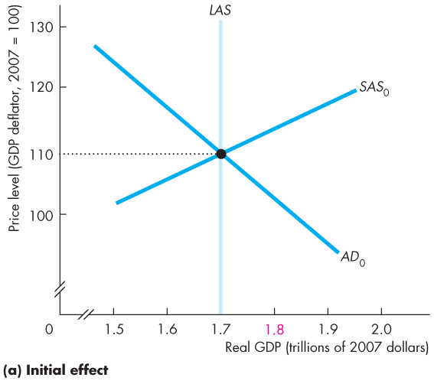
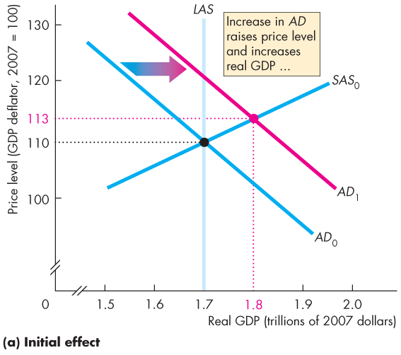
Inflation Cycles
Initial Effect of an Increase in Aggregate Demand
  Figure 28.3(a) illustrates the start of a demand-pull inflation.
  Starting from full employment, an increase in aggregate demand shifts the AD curve rightward.

Slide 33

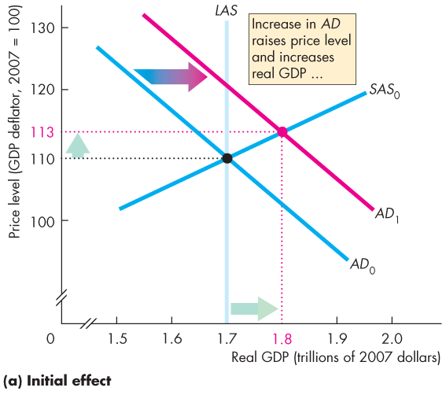

Slide 34
Inflation Cycles
  The price level rises, real GDP increases, and an inflationary gap arises.
  The rising price level is the first step in the demand-pull inflation.

Slide 35
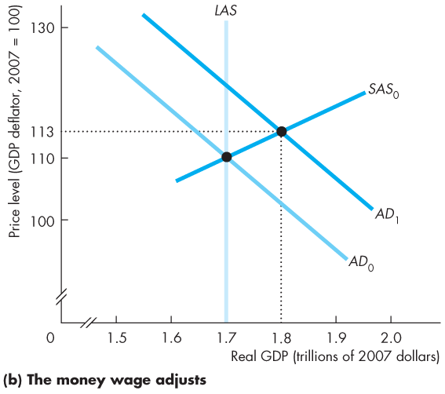
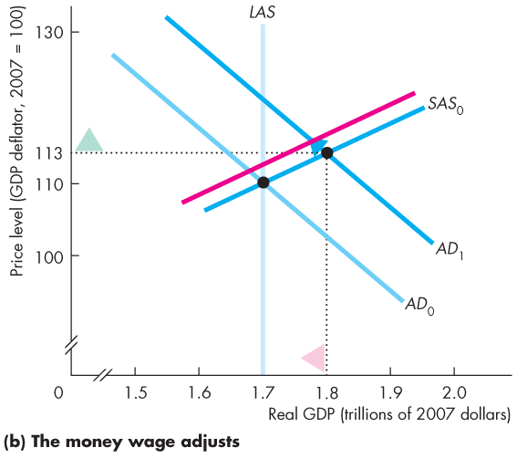
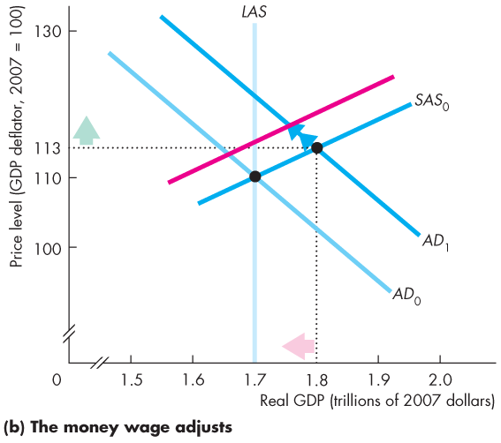
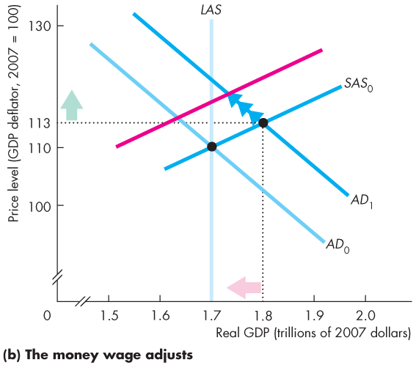
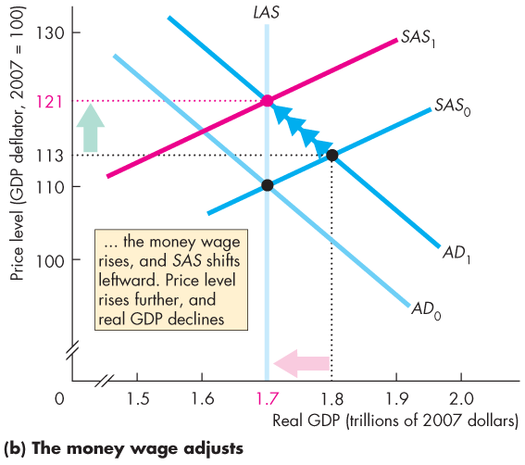
Inflation Cycles
Money Wage Rate Response
  Figure 28.1(b) shows that the money wage rate rises and the SAS curve shifts leftward.
  The price level rises and real GDP decreases back to potential GDP.

Slide 37
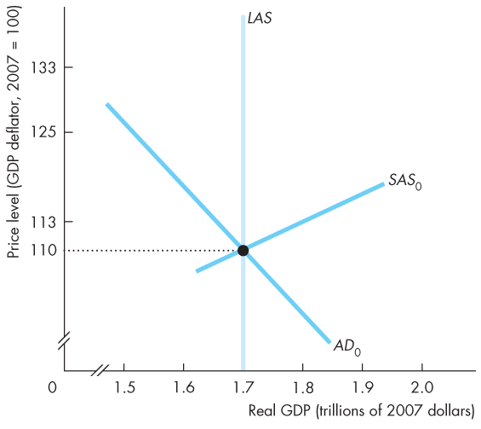
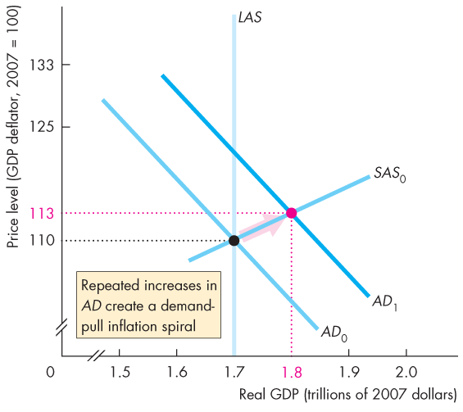
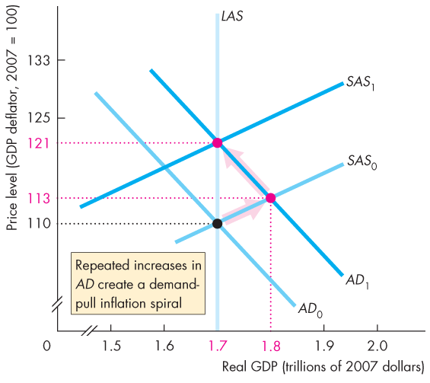
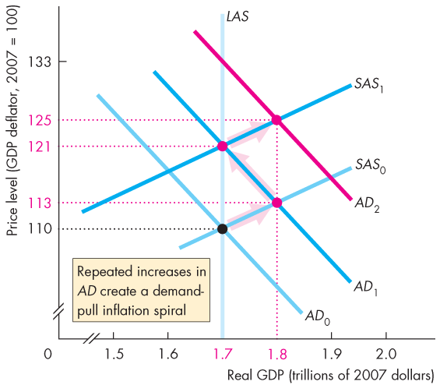
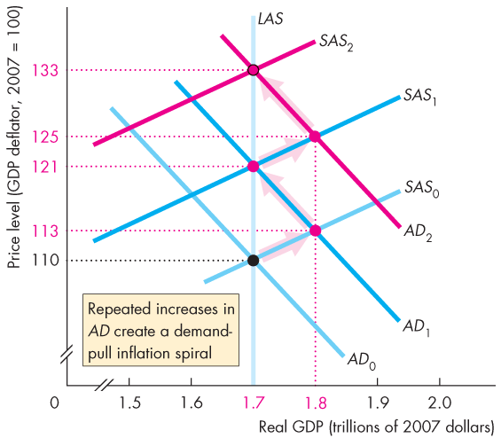

Inflation Cycles
A Demand-Pull Inflation Process
  Figure 28.4 illustrates a demand-pull inflation spiral.
  Aggregate demand keeps increasing and the process just described repeats indefinitely.

Slide 39
Inflation Cycles
  Several factors can increase aggregate demand to start a demand-pull inflation, …
  but only an ongoing increase in the quantity of money can sustain it.
  A demand-pull inflation occurred in Canada in the 1960s.

Slide 40
Inflation Cycles
  Cost-Push Inflation
  An inflation that starts with an increase in costs is called cost-push inflation.
  There are two main sources of increased costs:
  1. An increase in the money wage rate
  2. An increase in the money price of raw materials, such as oil
Notes:
The text gives a good description of the first oil price increase in the 1970s as a cost-push inflation, and contrasts it well with the Bank of Canada’s refusal to accommodate the second oil price increase in 1979. An explanation of how cost-push can be a more widespread cause of inflation in other countries can be given in terms of countries where labour is highly unionized, and in effect there are attempts by different interest groups to obtain shares of GDP that add up to more than 100 percent, with accommodation by a weak monetary authority. Such a process of repeated wage increases, inflation, and monetary accommodation can give rise to continuing inflation.
Analysts often “explain” the cause of inflation by focusing attention on the good or service whose price increased the most during the most recent time period. This is incorrect; inflation is cased by monetary growth. One way to point out the fallacy is to use a baseball analogy. Several years ago the average number of home runs hit during major league baseball games increased. Virtually every commentator asked whether the ball had been doctored to make it livelier. No one explained the additional home runs by saying “home runs are higher because Parkin is hitting more home runs than last year.” To explain inflation, economists are looking for an explanation similar to the “doctored ball” explanation of the additional home runs, not an explanation that focuses on the performance of specific players.

Slide 41
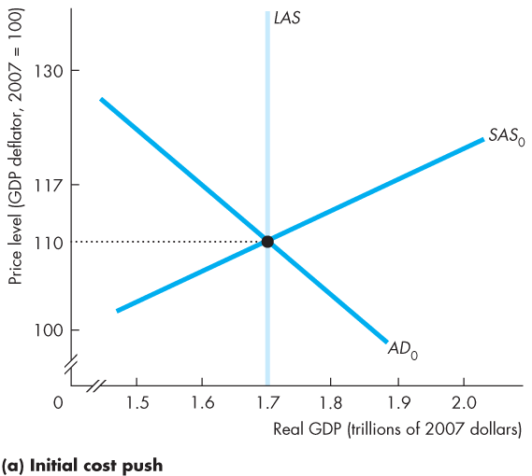
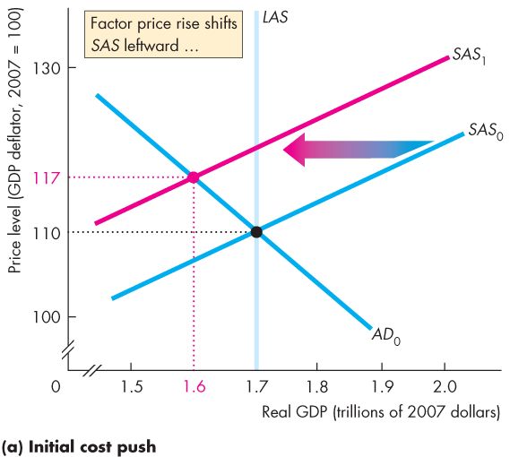
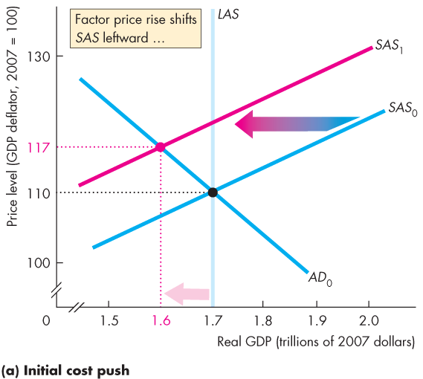
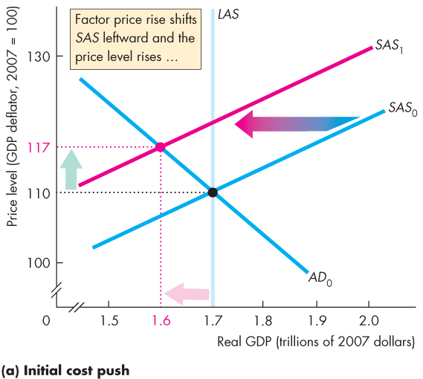
Inflation Cycles
Initial Effect of a Decrease in Aggregate Supply
  Figure 28.5(a) illustrates the start of cost-push inflation.
  If oil producers cut production and raise the price of oil short-run aggregate supply decreases and the SAS curve shifts leftward.
  Real GDP decreases and the price level rises.

Slide 43
Inflation Cycles
Aggregate Demand Response
  The initial increase in costs creates a one-time rise in the price level, not inflation.
  To create inflation, aggregate demand must increase.
  That is, the Bank of Canada must increase the quantity of money persistently.

Slide 44
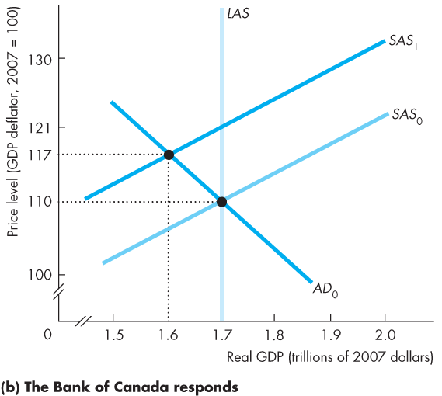
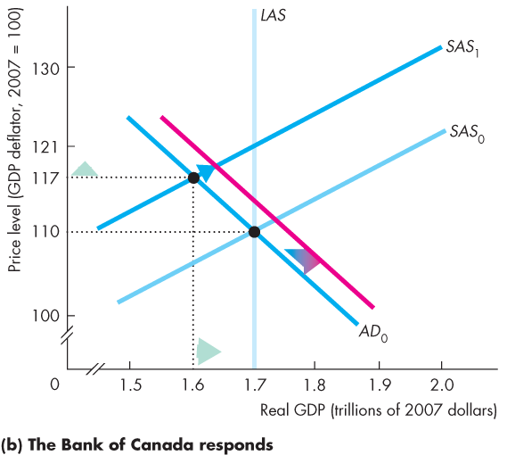
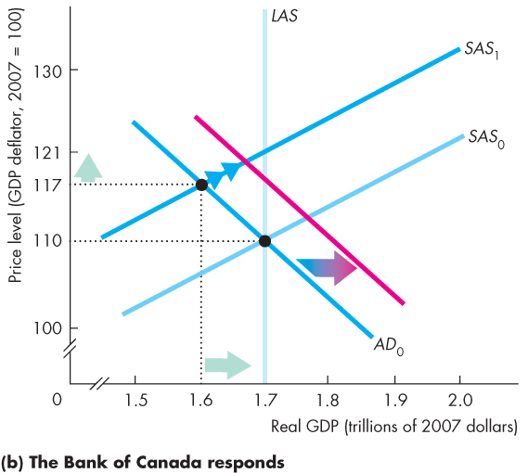
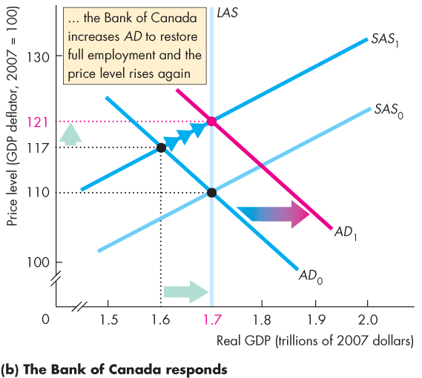
Inflation Cycles
  Figure 28.5(b) illustrates an aggregate demand response.
  The Bank of Canada stimulates aggregate demand to counter the higher unemployment.
  Real GDP increases and the price level rises again.

Slide 46
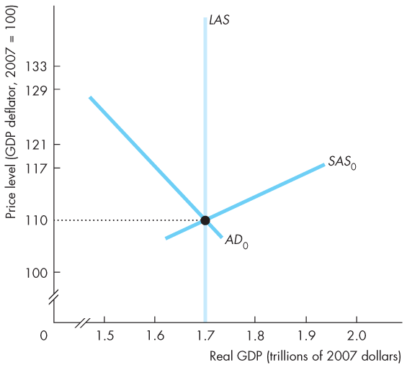
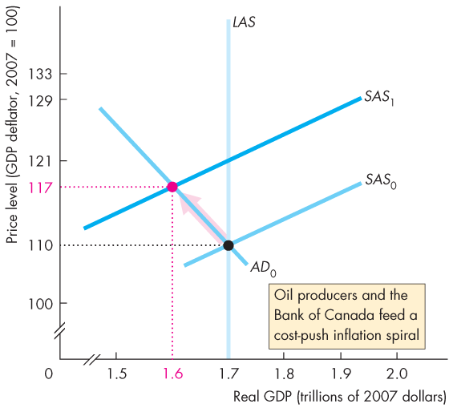
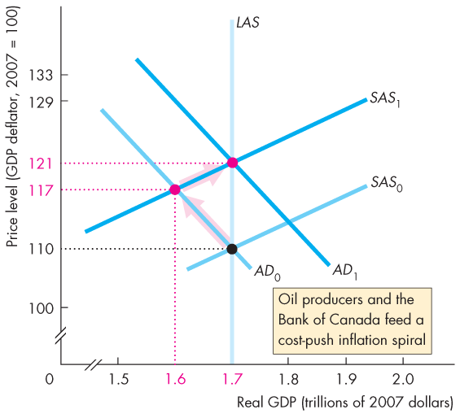
Inflation Cycles
A Cost-Push Inflation Process
  If the oil producers raise the price of oil to try to keep its relative price higher, …
  and the Bank of Canada responds by increasing the quantity of money, …
  a process of cost-push inflation continues.

Slide 47
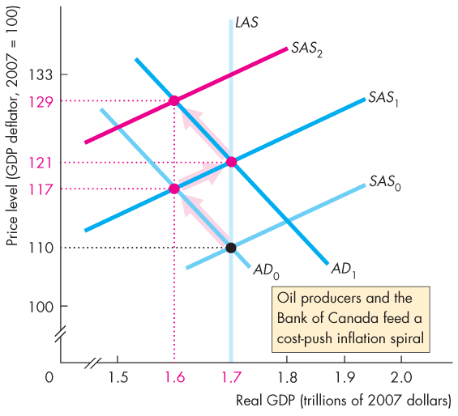
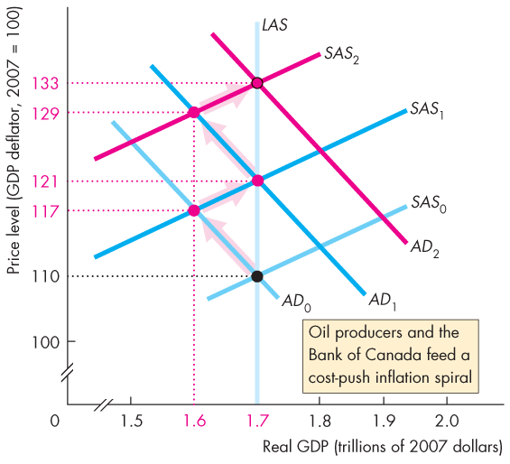


Slide 48
Inflation Cycles
  The combination of a rising price level and a decreasing real GDP is called stagflation.
  Cost-push inflation occurred in Canada during the 1970s when the Bank responded to the OPEC oil price rise by increasing the quantity of money.

Slide 49
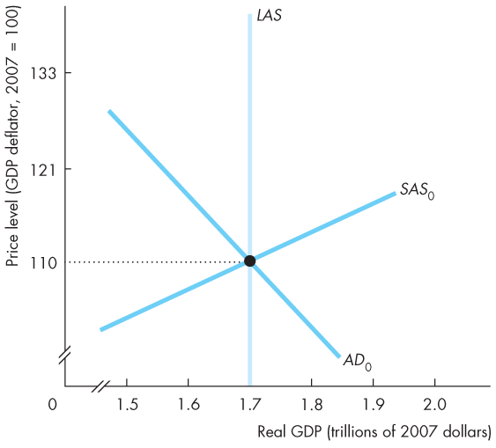
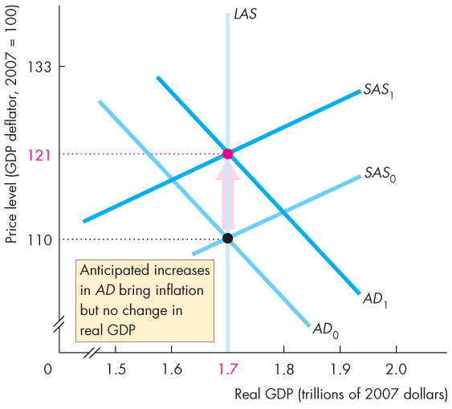
Inflation Cycles
Expected Inflation
  Aggregate demand increases, but the increase is expected, so its effect on the price level is expected.
  The money wage rate rises in line with the expected rise in the price level.
  Figure 28.7 illustrates.

Slide 50
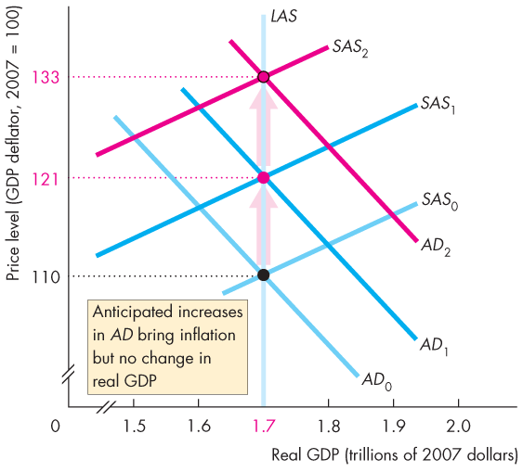
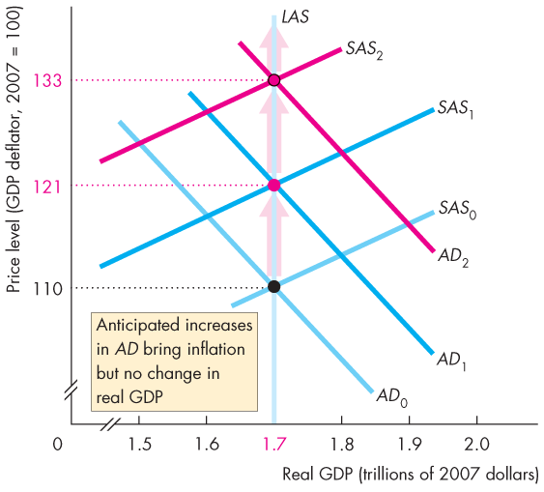

Slide 51
Inflation Cycles
  The price level rises
  as expected and real GDP remains at potential GDP.
  The process repeats.

Slide 52
Inflation Cycles
Forecasting Inflation
  To expect inflation, people must forecast it.
  The best forecast available is one that is based on all the relevant information and is called a rational expectation.
  A rational expectation is not necessarily correct, but it is the best available.

Slide 53
Inflation Cycles
Inflation and the Business Cycle
  When the inflation forecast is correct, the economy operates at full employment.
  If aggregate demand grows faster than expected, real GDP moves above potential GDP, …
  the inflation rate exceeds its expected rate and the economy behaves like it does in a demand-pull inflation.
  If aggregate demand grows more slowly than expected, …
  real GDP falls below potential GDP, inflation slows, and the economy behaves like it does in a cost-push inflation.

Slide 54
Deflation
An economy experiences deflation when it has a persistently falling price level.
What causes deflation?
What are the consequences of deflation?
  How can deflation be ended?

Slide 55
Deflation
What Causes Deflation
The price level falls persistently if aggregate demand increases at a persistently slower rate than aggregate supply.
The Quantity Theory and Deflation
Inflation rate = Money growth rate + Rate of velocity change – Real GDP growth rate
Deflation occurs if
Money growth rate < Real GDP growth rate – Rate of velocity change.

Slide 56
Deflation
For example in Japan, real GDP growth rate was 0.8 percent a year, the money growth rate was 2.5 percent a year, and the rate of velocity change was –3 percent a year.
Inflation rate = Money growth rate + Rate of velocity change – Real GDP growth rate
Inflation rate = [2.5 + (– 3) – 0.8] percent a year.
Deflation rate = 1.3 percent a year.
Notes:
Classroom activity
Check out Economics in Action: Fifteen Years of Deflation in Japan

Slide 57
Deflation
What are the Consequences of Deflation?
Unanticipated deflation redistributes income and wealth, lowers real GDP and employment, and diverts resources from production.
  How can deflation be ended?
  By increasing the growth rate of money.
  Make the money growth rate exceed the growth rate of real GDP minus the rate of velocity change.
Notes:
Classroom activity
Check out Economics in the News: The Stagnating Eurozone

Slide 58
The Phillips Curve
  A Phillips curve is a curve that shows the relationship between the inflation rate and the unemployment rate.
  There are two time frames for Phillips curves:
  The short-run Phillips curve
  The long-run Phillips curve
Notes:
The Phillips curve story nicely illustrates how progress is made in economics.
The story starts in 1958 when Bill Phillips published his famous paper. At that time the mainstream economic model was the aggregate expenditure model presented in Chapter 27. The model was based on the assumption that the price level was constant, making the inflation rate zero. This assumption was not too unrealistic immediately after World War II. By 1955, though, the inflation rate began to creep higher and averaged 2.7 percent per year between 1956 and 1959. Inflation was beginning to be perceived as a problem, one that a model with a “fixed price level assumption” was poorly suited to solve.
In this environment, economists gladly welcomed the simple, short-run Phillips curve, for it gave them a handle on inflation. They believed that they could predict the unemployment rate from their standard model and then combine this unemployment rate with the Phillips curve to determine the resulting inflation rate. The vital assumption in this procedure is that the Phillips curve captures a fixed tradeoff between the actual inflation rate and the unemployment rate that is part of the economy’s structure.
This type of analysis reached its peak of popularity during the early and middle 1960s.
But by 1967 it was under attack. On a theoretical level, Ned Phelps and Milton Friedman pointed out the flimsy justification behind the simple, fixed Phillips curve assumption. On an empirical level, the fixed Phillips curve failed as the inflation rate rose toward the end of the 1960s and into the 1970s: the unemployment rate did not fall as predicted by the fixed Phillips curve.
At this point the idea of a long-run Phillips curve (as distinct from the short-run one) was developed. The concept that aggregate supply is an important component of macroeconomics was taking hold, as was the idea that short-run Phillips curves shift because of changes in people’s expectations. Thus the profession advanced significantly between the initial discussion of the Phillips curve and what students learn today. This advance was the result of the interaction between theory, suggesting that the idea of a fixed short-run Phillips curve was inadequate, and empirical work that reinforced the point that the simple, early approach was deficient.

Slide 59
The Phillips Curve
The Short-Run Phillips Curve
  The short-run Phillips curve shows the tradeoff between the inflation rate and unemployment rate, holding constant
  1. The expected inflation rate
  2. The natural unemployment rate

Slide 60
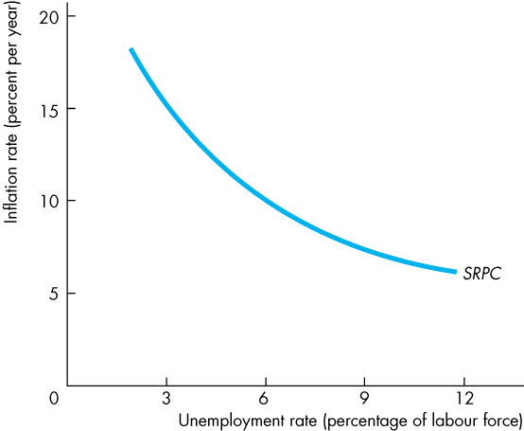
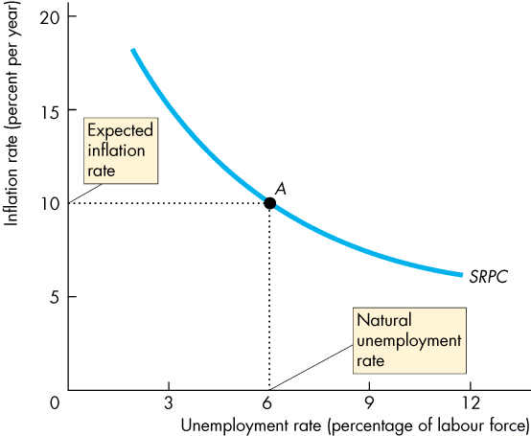
The Phillips Curve
  Figure 28.8 illustrates a short-run Phillips curve (SRPC)—a downward-sloping curve.
  It passes through the natural unemployment rate and the expected inflation rate.

Slide 61

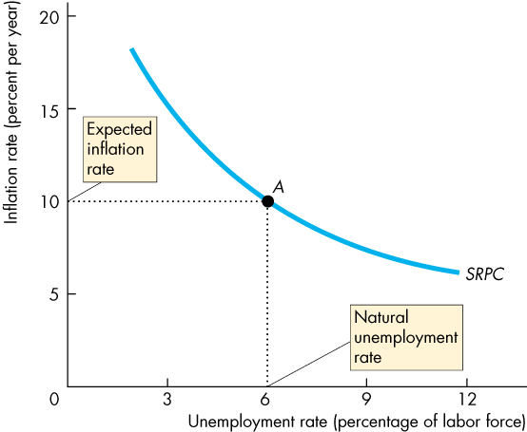



Slide 62
The Phillips Curve
  With a given expected inflation rate and natural unemployment rate:
  If the inflation rate exceeds the expected inflation rate, the unemployment rate decreases.
  If the inflation rate is below the expected inflation rate, the unemployment rate increases.

Slide 63
The Phillips Curve
The Long-Run Phillips Curve
  The long-run Phillips curve shows the relationship between inflation and unemployment when the actual inflation rate equals the expected inflation rate.

Slide 64

The Phillips Curve
  Figure 28.9 illustrates the long-run Phillips curve (LRPC), which is vertical at the natural unemployment rate.
  Along LRPC, a change in the inflation rate is expected, so the unemployment rate remains at the natural unemployment rate.

Slide 65

The Phillips Curve
  The SRPC intersects the LRPC at the expected inflation rate—10 percent a year in the figure.
  Change in Expected Inflation
  If expected inflation falls to 6 percent a year, ...
  the short-run Phillips curve shifts downward by an amount equal to the fall in the expected inflation rate.

Slide 67


The Phillips Curve
Change in the Natural Unemployment Rate
  A change in the natural unemployment rate shifts both the long-run and short-run Phillips curves.
  Figure 28.10 illustrates.
Notes:
Classroom activity
Check out Economics in Action: The Canadian Phillips Curve

